Slide 1
Lesson 1
CAN Protocol Basics

Slide 2
Contents
CAN introduction
CAN Properties
CAN features
CAN bus and Network Topology

Slide 3
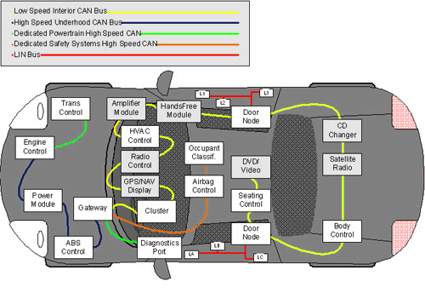
1/ CAN introduction - What is CAN?
Controller
Area
Network
The Controller Area Network (CAN bus) is the nervous system, enabling communication between nodes.

Slide 4
CAN introduction - Topic
Why CAN? What is it's application?
What is it's benefits compare to other protocol used in Automotive? (Flexray,MOST, Ethernet,…)
※Hint: check in term of Physical bus type, Speed, Data length, Transmission type, Fault tolerance, Cost/Price,…

Slide 5
CAN properties - Topic
What is CAN protocol characteristics?
  Wired/Wireless?
  Serial/Parallel?
  Synchronous/Asynchronous?
  Peer2Peer/Broadcast?
  Message Based Protocol/Node-Node Protocol?
  How do Message filter?
  Simplex/Half Duplex/Full Duplex?
  Acknowledgement method?
  CSMA Protocol?
  Fault Confinement?
  …etc…

Slide 6
CAN features - Topic
What is the speed used in CAN protocol?
Is there any limitation for data sent by CAN?

Slide 7
CAN bus and Network Topology - Topic
How do CAN bus work? (check in term of physical layer)
Why do CAN bus need to be twisted pair?
Sequence of transmitting and receiving a CAN message from one node to other nodes. (How does digital data 1/0 go from Microcontroller to analog data in CAN bus?)
Hint: Using CAN Transceiver, CAN Controller.
Map CAN with OSI model

Slide 8
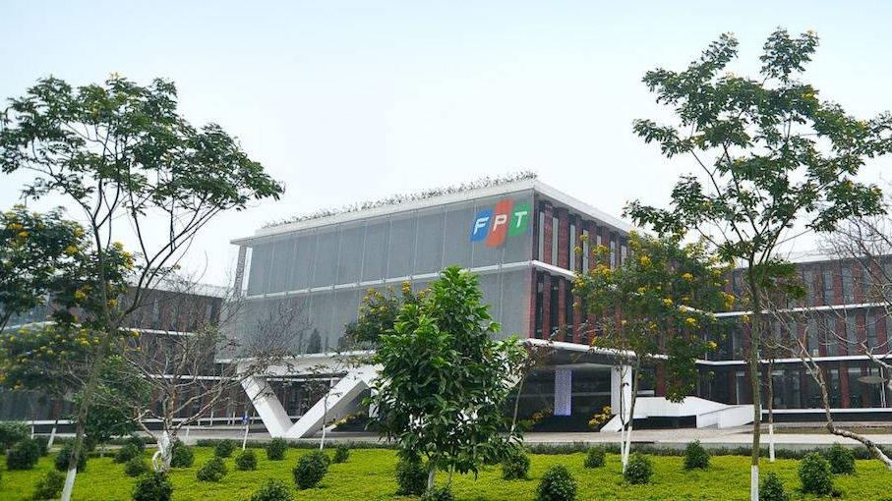


THANK YOU

